Slide 1
ONE BYTE
INSTRUCTIONS

Slide 2
TIMING DIAGRAM FOR MOVE DATA (MOV R_{d} , R_{s})
Here R_{d} represents the destination register where data is to be moved and R_{s} represents the source register from where data is to be moved.
ADDRESS | MNEMONICS | OP-CODE
1000H | MOV B,C | 41_{H}
T₁ : The 1st clock of 1st machine cycle (M₁) makes ALE high indicating address latch enabled which loads low-order address 00H on AD₇ ⇔ AD₀ and high-order address 10H simultaneously on A₁₅ ⇔ A₈. The address 00H is latched in T₁.
T₂ : During T₂ clock, the microprocessor issues RD control signal to enable the memory and processor places 41H from 1000H location on the data bus.
T₃ : During T₃, the 41H is placed in the instruction register and RD = 1 (high) disables signal. It means the memory is disabled in T₃ clock cycle. The opcode cycle is completed by end of T₃ clock cycle.
T₄ : The op-code is decoded in T₄ clock and the action as per 41H is taken accordingly. In other words, the content of C-register is copied in B-register.

Slide 3
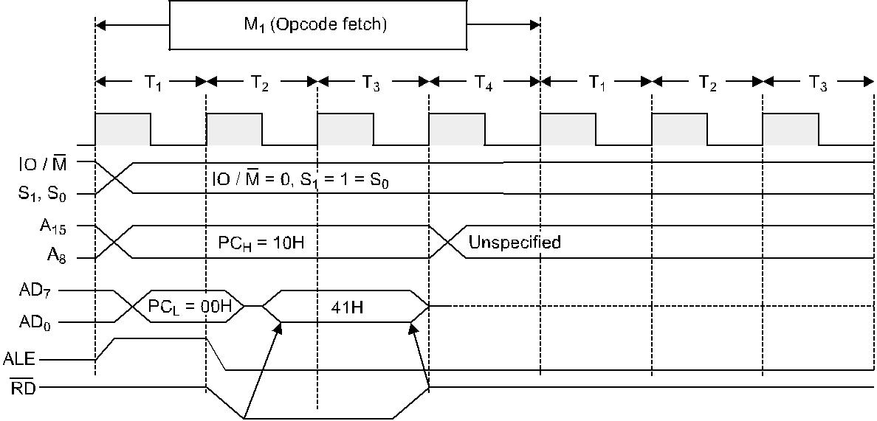

Slide 4
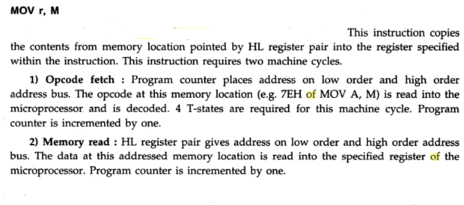
TIMING DIAGRAM FOR MOV r , M

Slide 5
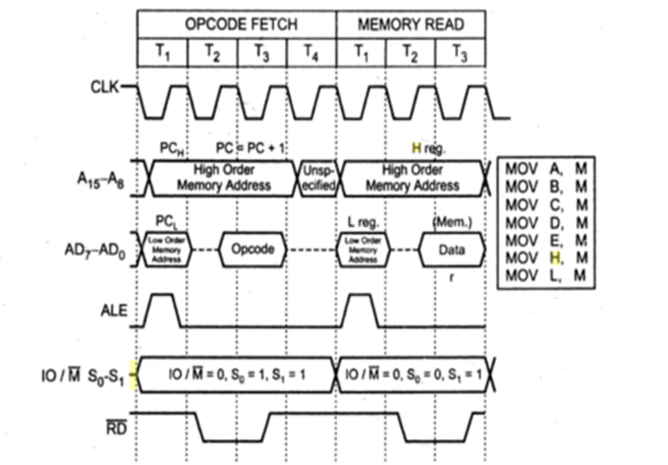

Slide 6
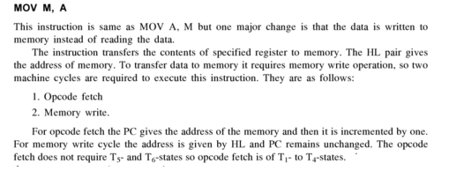
TIMING DIAGRAM FOR MOV M , r
EXAMPLE :-

Slide 7
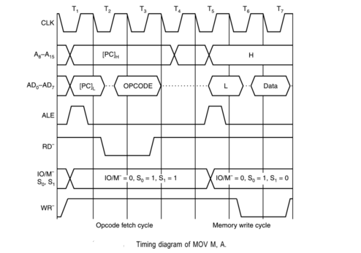

Slide 8
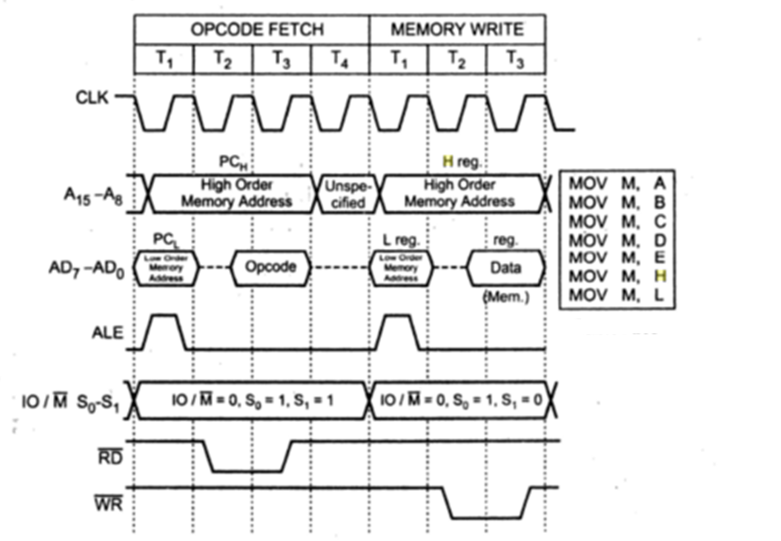

Slide 9
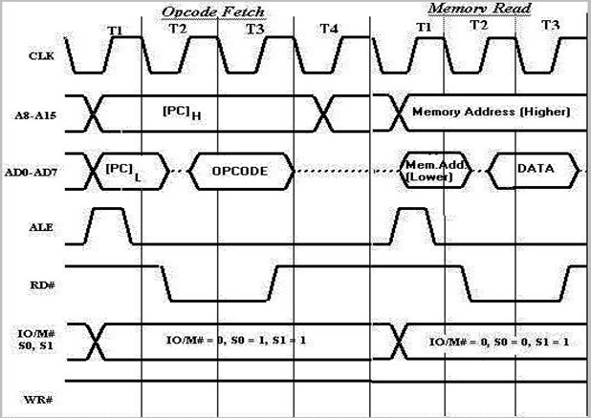
TIMING DIAGRAM FOR ADD M

Slide 10
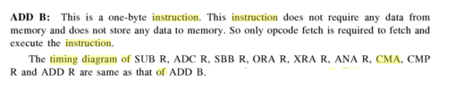
TIMING DIAGRAM FOR ADD R
EXAMPLE :- ADD B
ADDRESS | MNEMONICS | OP-CODE
1000H | ADD B | 80_{H}

Slide 11
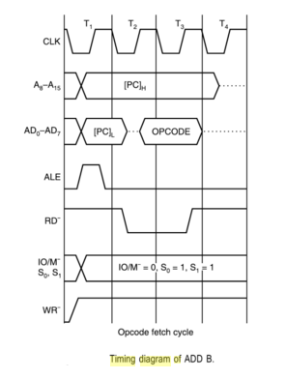
EXAMPLE :- ADD B

Slide 12
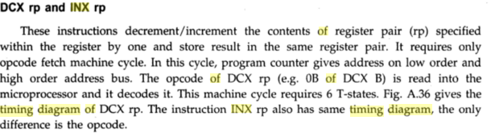
TIMING DIAGRAM FOR INX R_{P} and DCX R_{P}

Slide 13
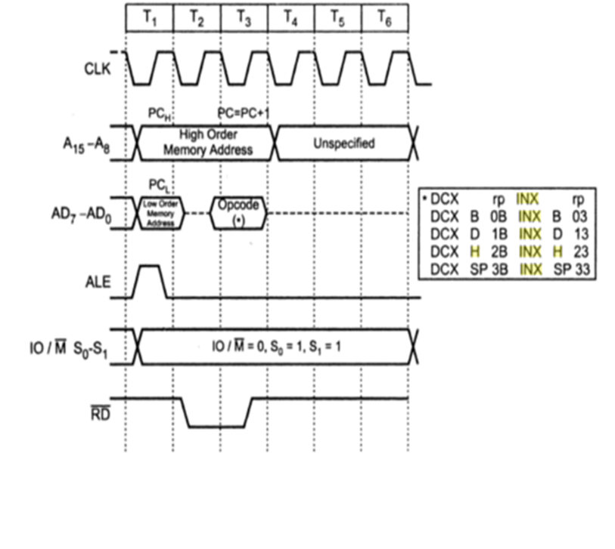

Slide 14
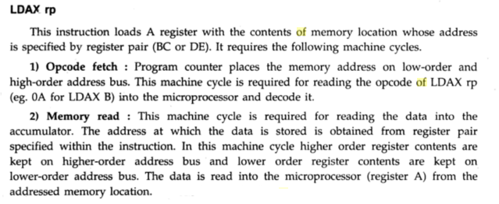
TIMING DIAGRAM FOR LDAX R_{P}

Slide 15
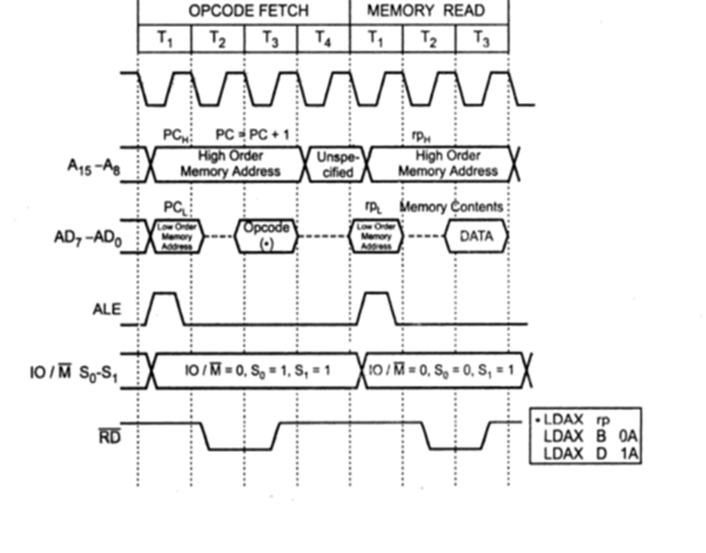

Slide 16
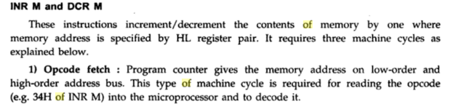
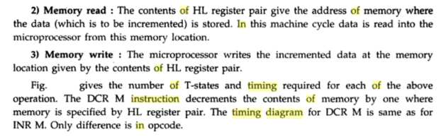
TIMING DIAGRAM FOR DCR M

Slide 17
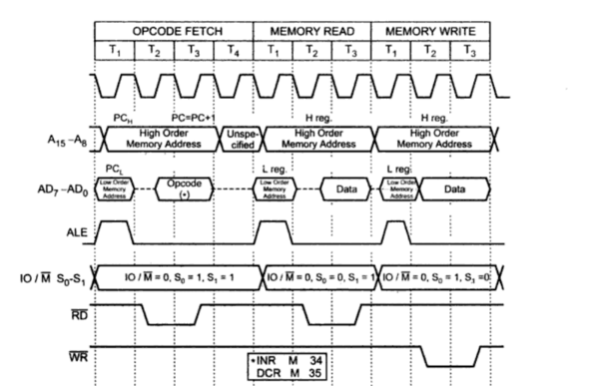

Slide 18
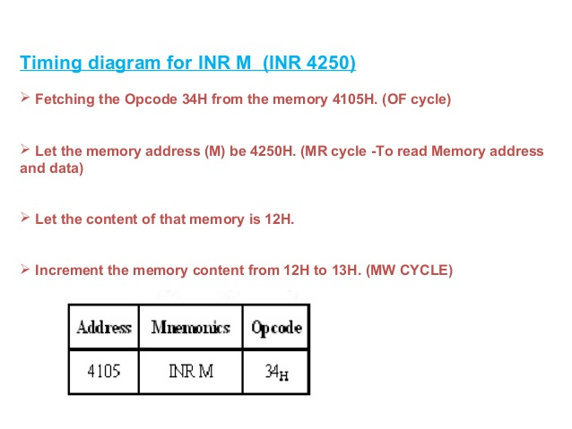

Slide 19
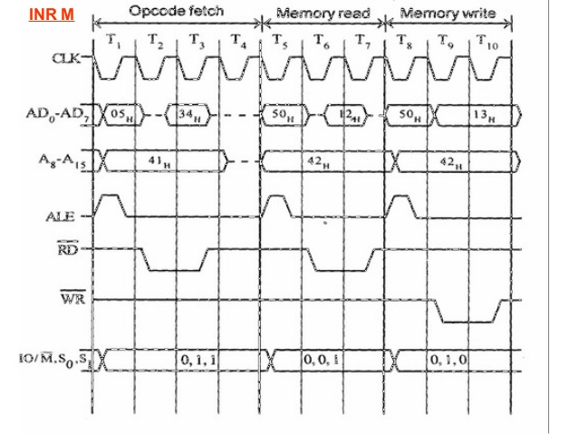

Slide 20
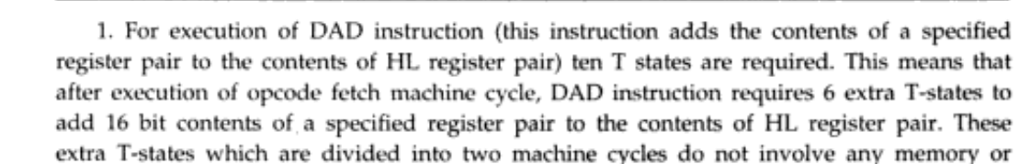
TIMING DIAGRAM FOR DAD (DAD R_{P} )
Example :- DAD B adds the content of register pair BC with content of register pair HL.

Slide 21
ADDRESS | MNEMONICS | OP-CODE
4000_{H} | DAD B | 09_{H}

Slide 22
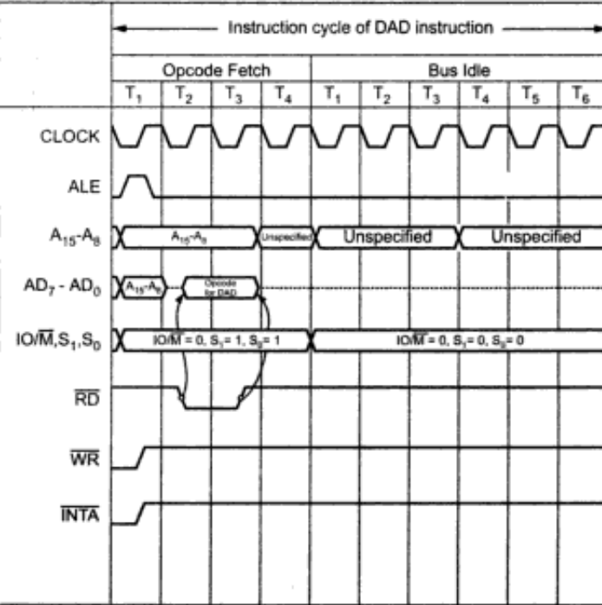

Slide 23
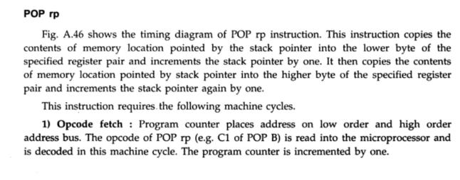
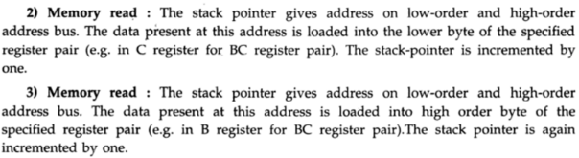
TIMING DIAGRAM FOR POP (POP R_{P} )

Slide 24
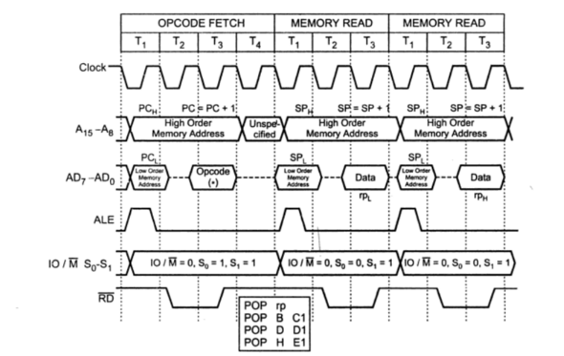

Slide 25
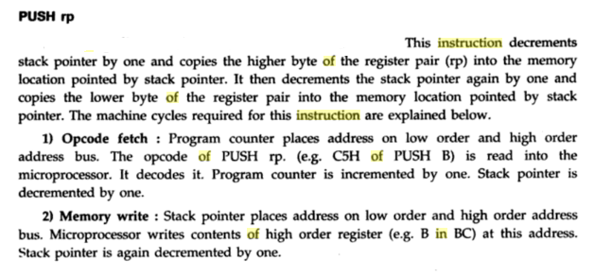
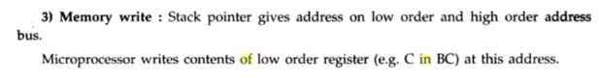
TIMING DIAGRAM FOR PUSH (PUSH R_{P} )

Slide 26
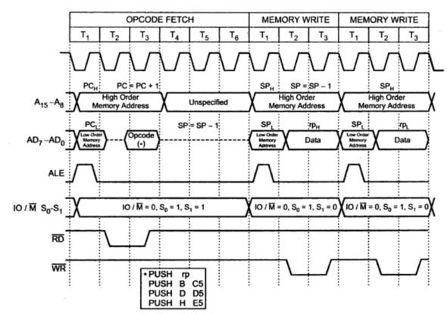

Slide 27
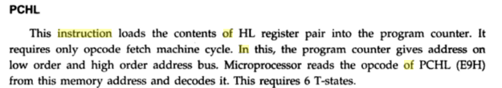
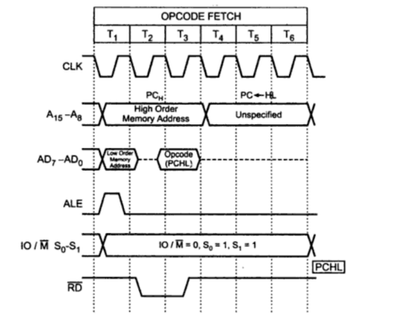
TIMING DIAGRAM FOR PCHL

Slide 28
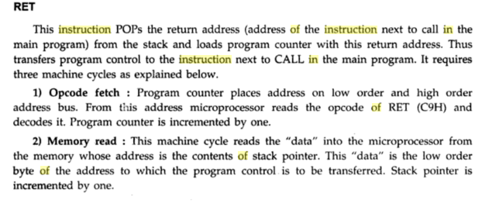
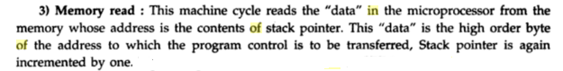
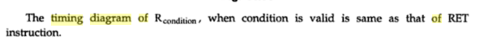
TIMING DIAGRAM FOR RET
Return from subroutine unconditionally
NOTE :-

Slide 29
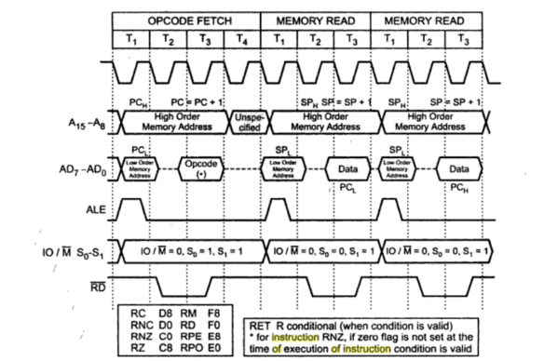

Slide 30
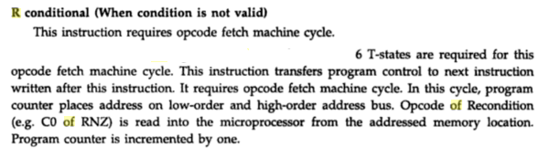
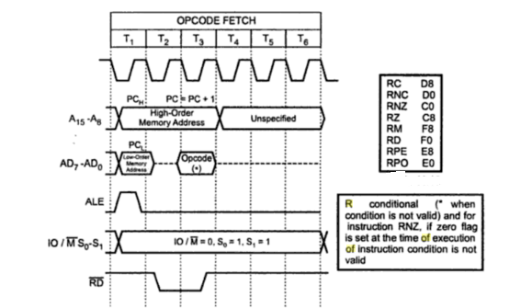

Slide 31
TWO BYTE
INSTRUCTIONS

Slide 32
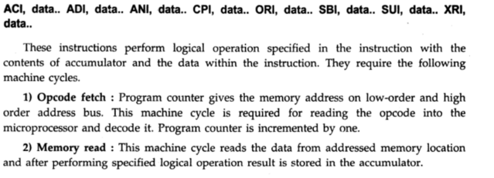
TIMING DIAGRAM FOR ACI Data, ADI Data, ANI Data, CPI Data, ORI Data, SBI Data, SUI Data, XRI Data

Slide 33
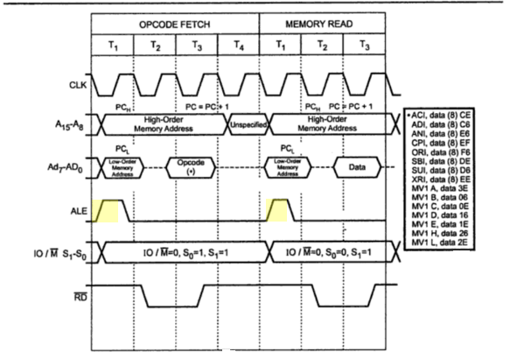

Slide 34
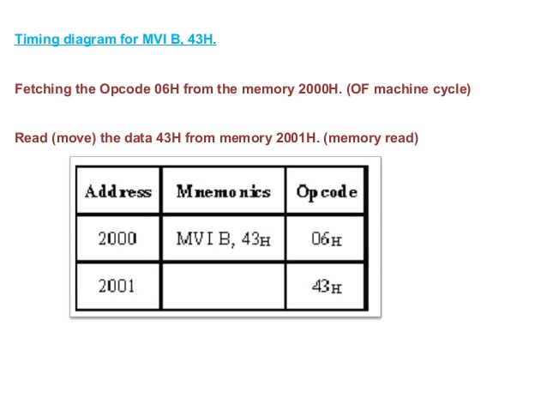
TIMING DIAGRAM FOR MVI R, DATA

Slide 35
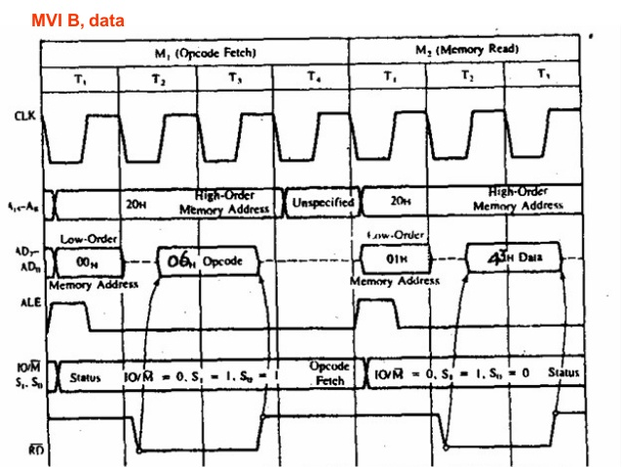

Slide 36
Example :- MVI A, DATA
ADDRESS | MNEMONICS | OP-CODE
2000 | MVI A,32_{H} | 3E
2001 |  | 32

Slide 37
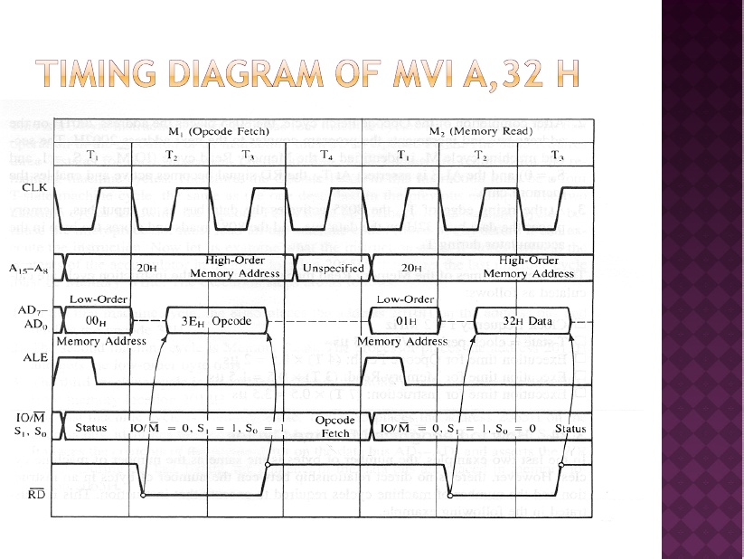

Slide 38
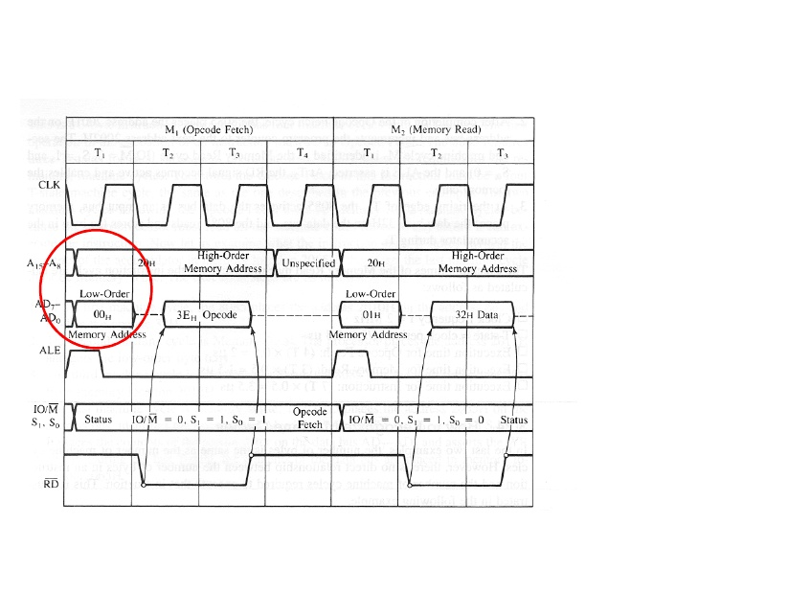
Put the first memory Location on the
address bus(2000 H)

Slide 39
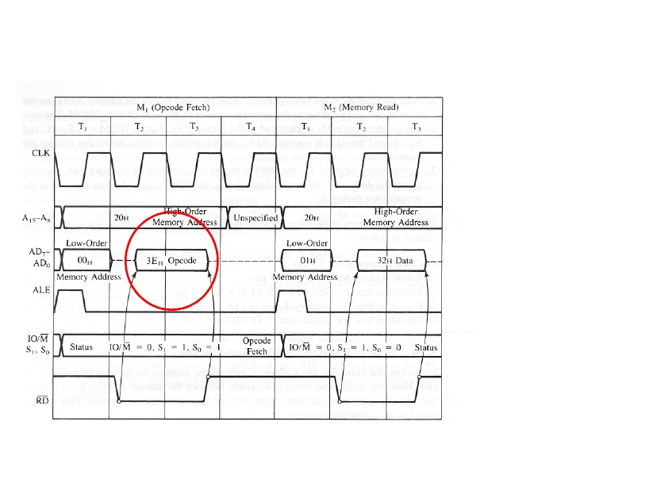
Get the
instruction(op-code) byte from
memory

Slide 40
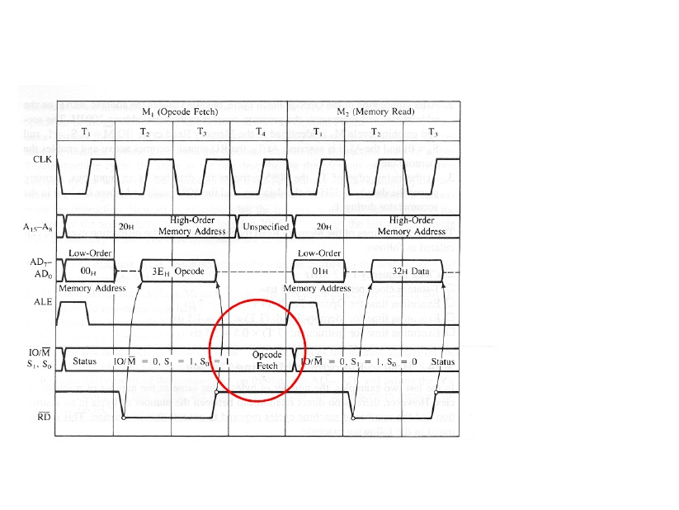
Interpret the Instruction : Wait for the data byte

Slide 41
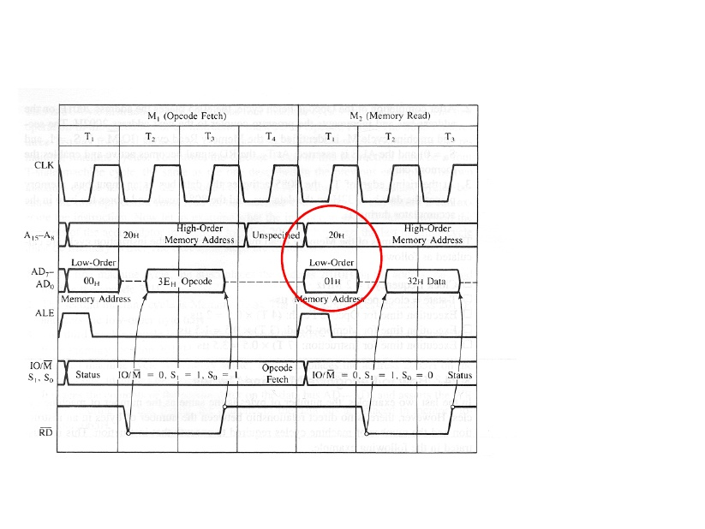
Put the next memory location on the address bus (2001 H)

Slide 42
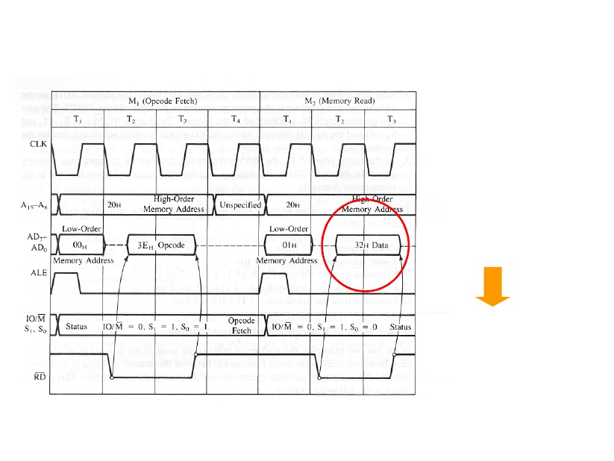
Get the data byte from the memory
Through data lines
This will be finally placed
into accumulator

Slide 43
TIMING DIAGRAM FOR IN port address.
Fetching the Op-code DBH from the memory 4125H.
Read the port address C0H from 4126H.
Read the content of port C0H and send it to the accumulator.
Let the content of port is 5EH.
ADDRESS | MNEMONICS | OP-CODE
4125 | IN C0_{H} | DB_{H}
4126 |  | C0_{H}

Slide 44
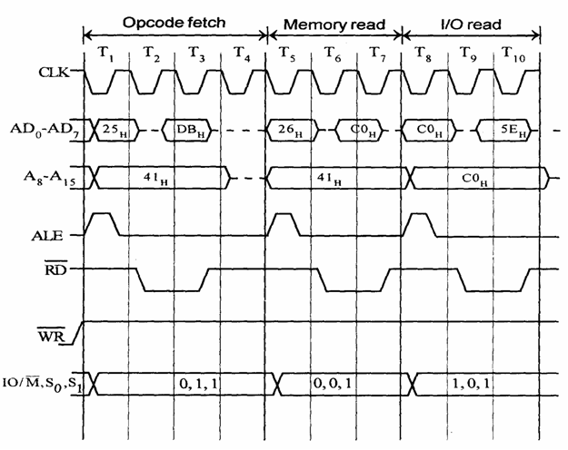
IN C0H

Slide 45
Timing diagram for OUT 8-bit port address.
ADDRESS | MNEMONICS | OP-CODE
4125 | OUT C0_{H} | D3_{H}
4126 |  | C0_{H}

Slide 46
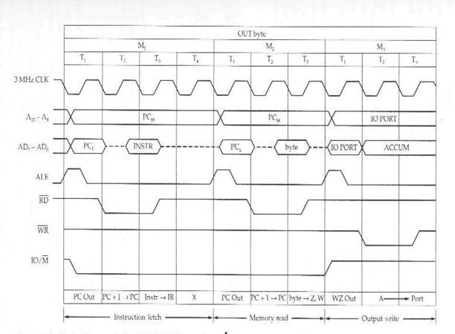
TIMING DIAGRAM FOR OUT 8-bit port address

Slide 47
THREE BYTE
INSTRUCTIONS

Slide 48
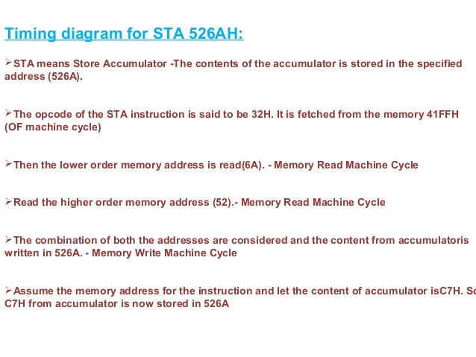

Slide 49
ADDRESS | MNEMONICS | OP-CODE
41FF | STA 526A_{H} | 32_{H}
4200 |  | 6A_{H}
4201 |  | 52_{H}

Slide 50
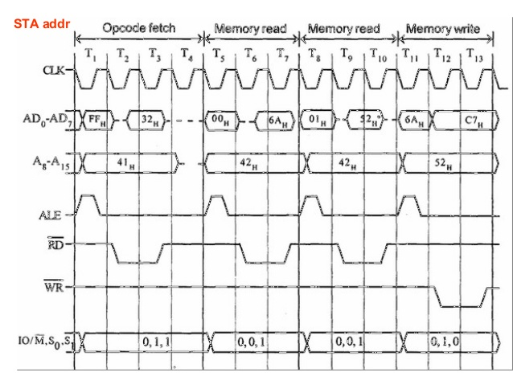

Slide 51
Timing diagram for LDA 16-BIT ADDRESS
ADDRESS | MNEMONICS | OP-CODE
4000 | LDA 2000 | 3A
4001 |  | 00
4002 |  | 20

Slide 52
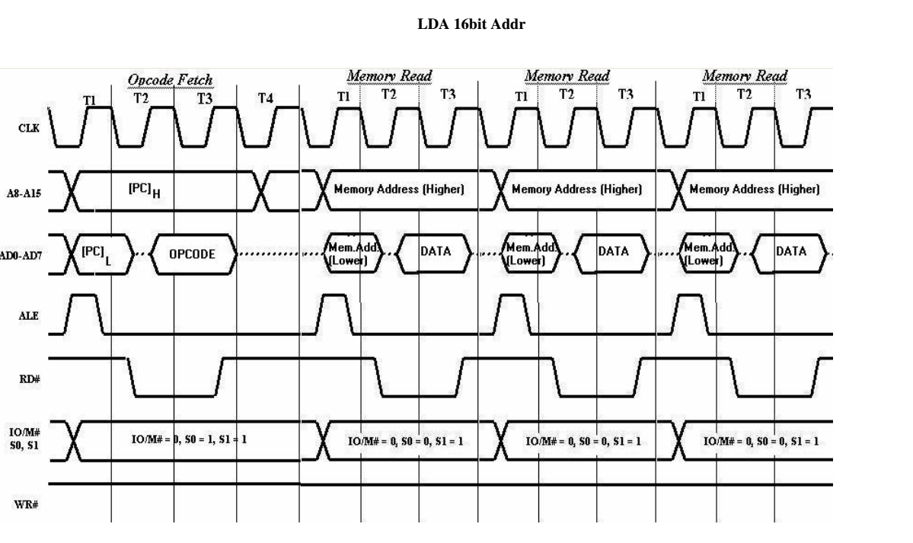

Slide 53
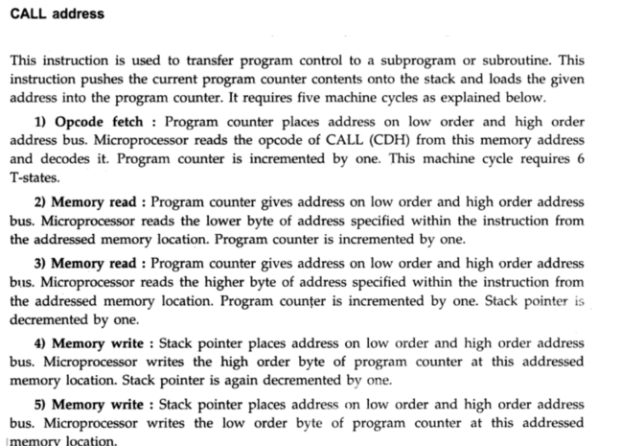
Timing diagram for CALL ADDRESS

Slide 54
ADDRESS | MNEMONICS | OP-CODE
4000 | CALL 2000 | CD
4001 |  | 00
4002 |  | 20

Slide 55


Slide 56


Slide 57


Timing diagram for LHLD 16-BIT ADDRESS

Slide 58
ADDRESS | MNEMONICS | OP-CODE
4000 | LHLD 2000 | 2A
4001 |  | 00
4002 |  | 20

Slide 59


Slide 60
Timing diagram for SHLD 16-BIT ADDRESS
ADDRESS | MNEMONICS | OP-CODE
4000 | SHLD 2000 | 22
4001 |  | 00
4002 |  | 20

Slide 61


Slide 62


Slide 63



Timing diagram for JMP 16-BIT ADDRESS

Slide 64


Slide 65



Slide 66
EXAMPLE :-
ADDRESS | MNEMONICS | OP-CODE
4000 | JMP 2000 | C3
4001 |  | 00
4002 |  | 20

Slide 67


Slide 68
Timing diagram for LXI R_{P}, 16-BIT DATA
ADDRESS | MNEMONICS | OP-CODE
4000 | LXI B, 2050 | 01
4001 |  | 50
4002 |  | 20

Slide 69


